Slide 1

Forests 2020:
Topographic Correction
Presented by
IPB

Slide 2
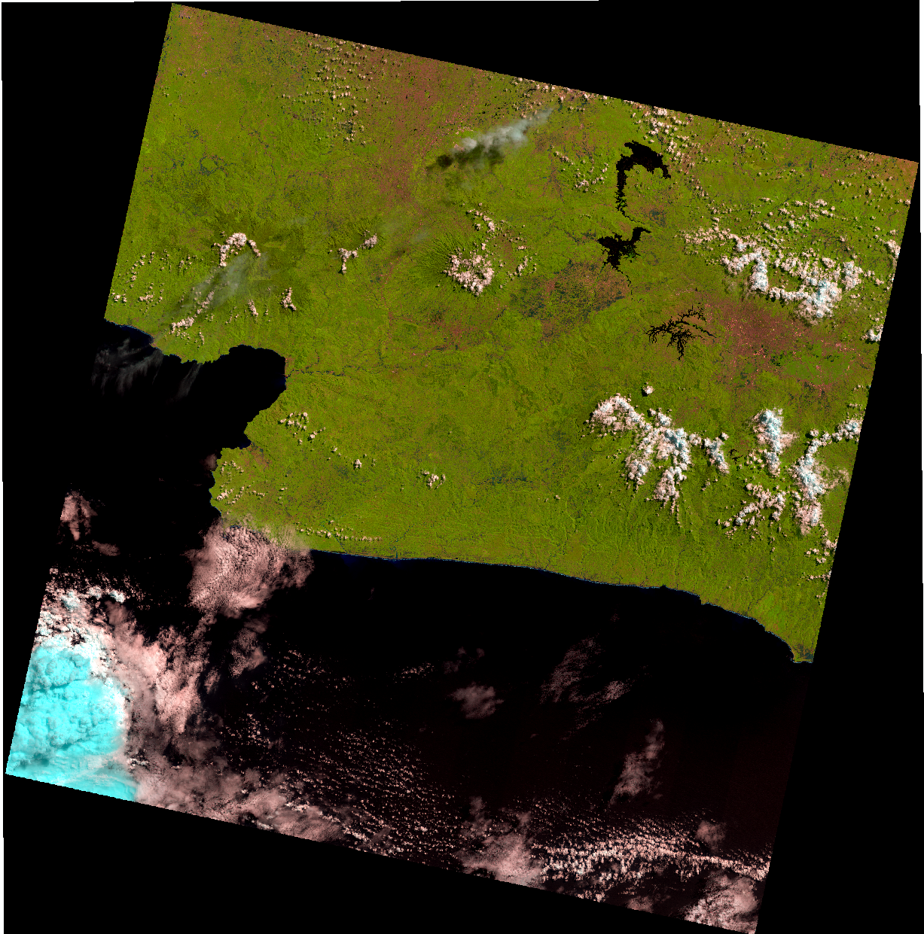
Topographic Correction
Band 654

Slide 3
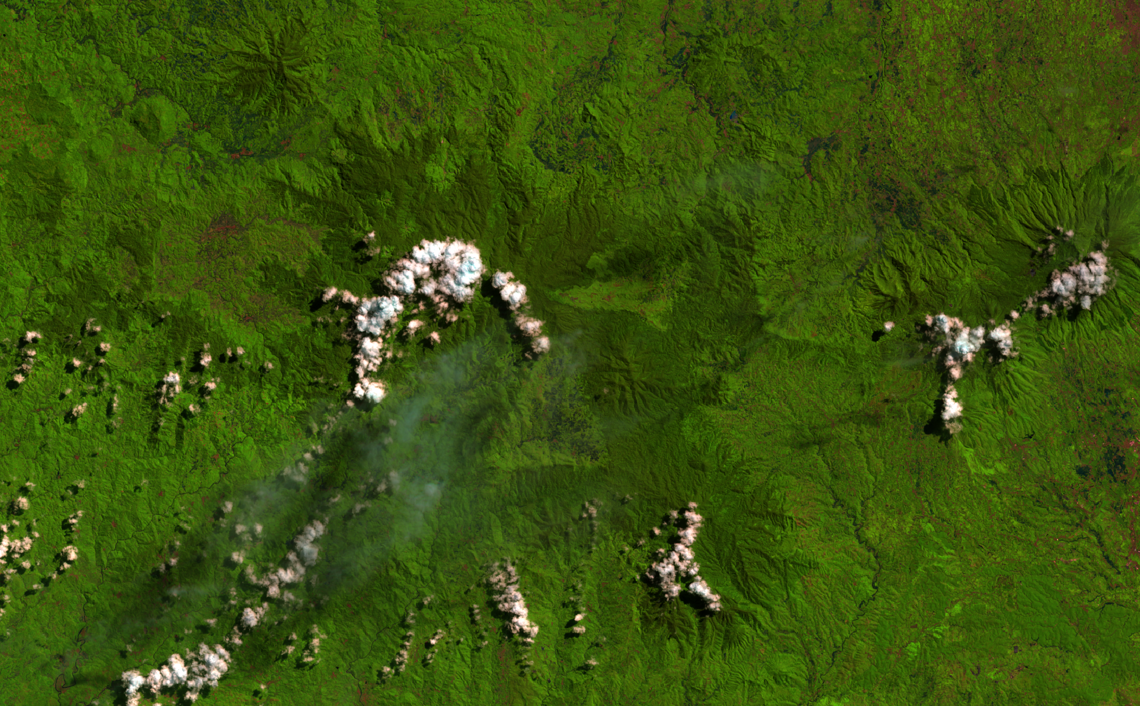
Window Area

Slide 4
Topographic Correction Procedures
Solar Position
Illumination Condition
Rotation Model

Slide 5
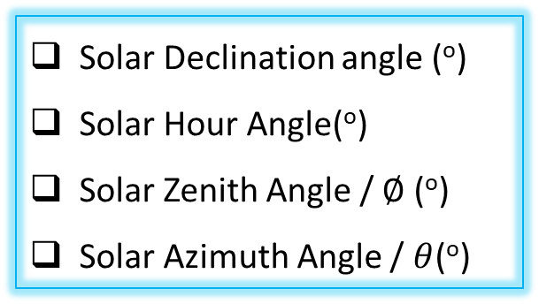
Solar Position Calculation
Adopted from NOAA (2014) as suggested by Prinsloo and Dablo (2015)
Solar Declination angle (º)
Solar Hour Angle(º)
Solar Zenith Angle / $∅$ (º)
Solar Azimuth Angle / $θ$(º)
Up
Zenith
North
Azimuth

Slide 6
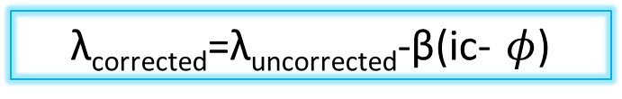
Illumination Condition
ic=cos⁡ $φ$ cos⁡ slope + sin⁡ $φ$ sin⁡ slope cos⁡(θ-aspect)
Rotation Model
λ_{corrected}=λ_{uncorrected}-β(ic- $φ$)
Digital Number
Illumination Condition

Slide 7
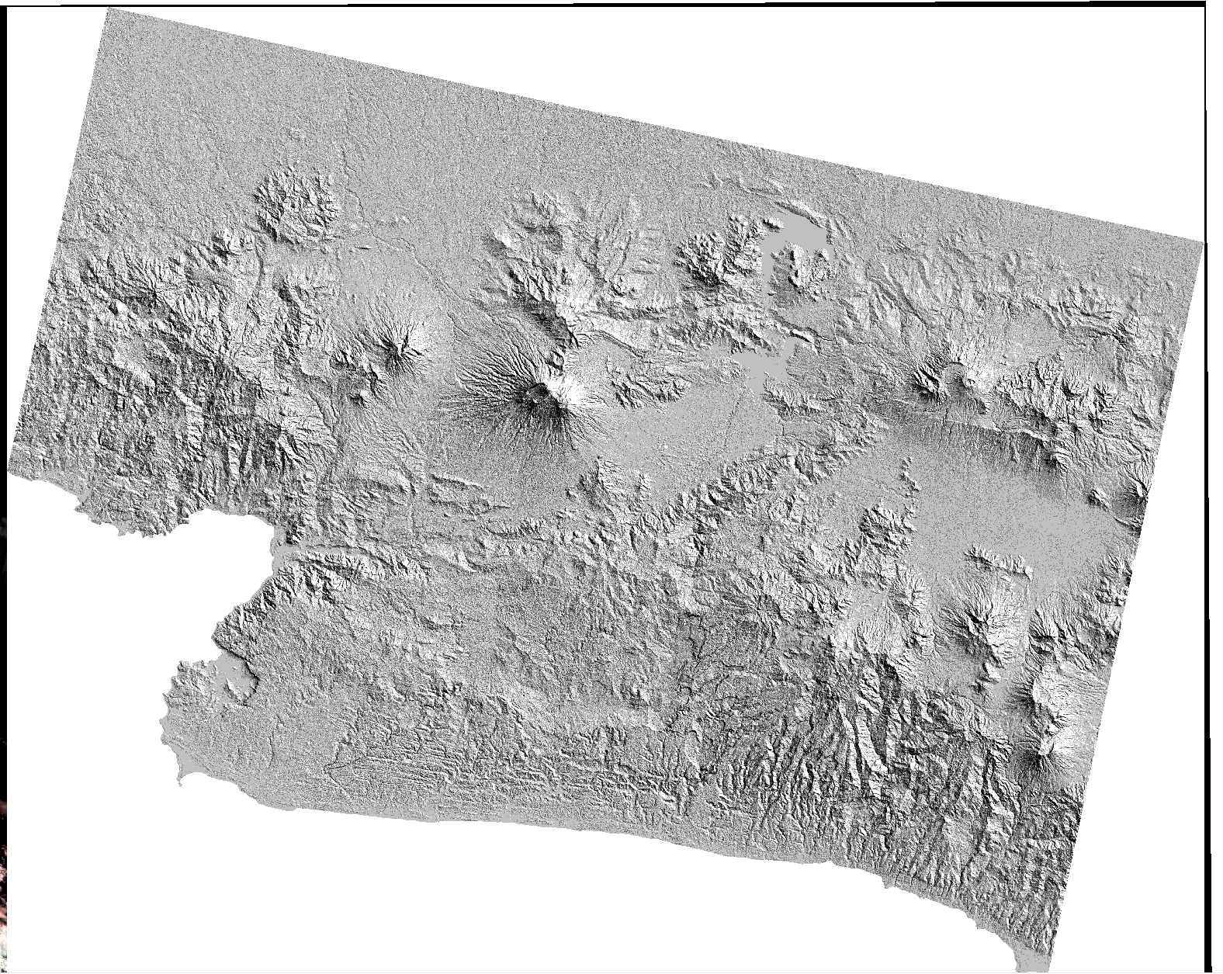
Illumination Condition

Slide 8
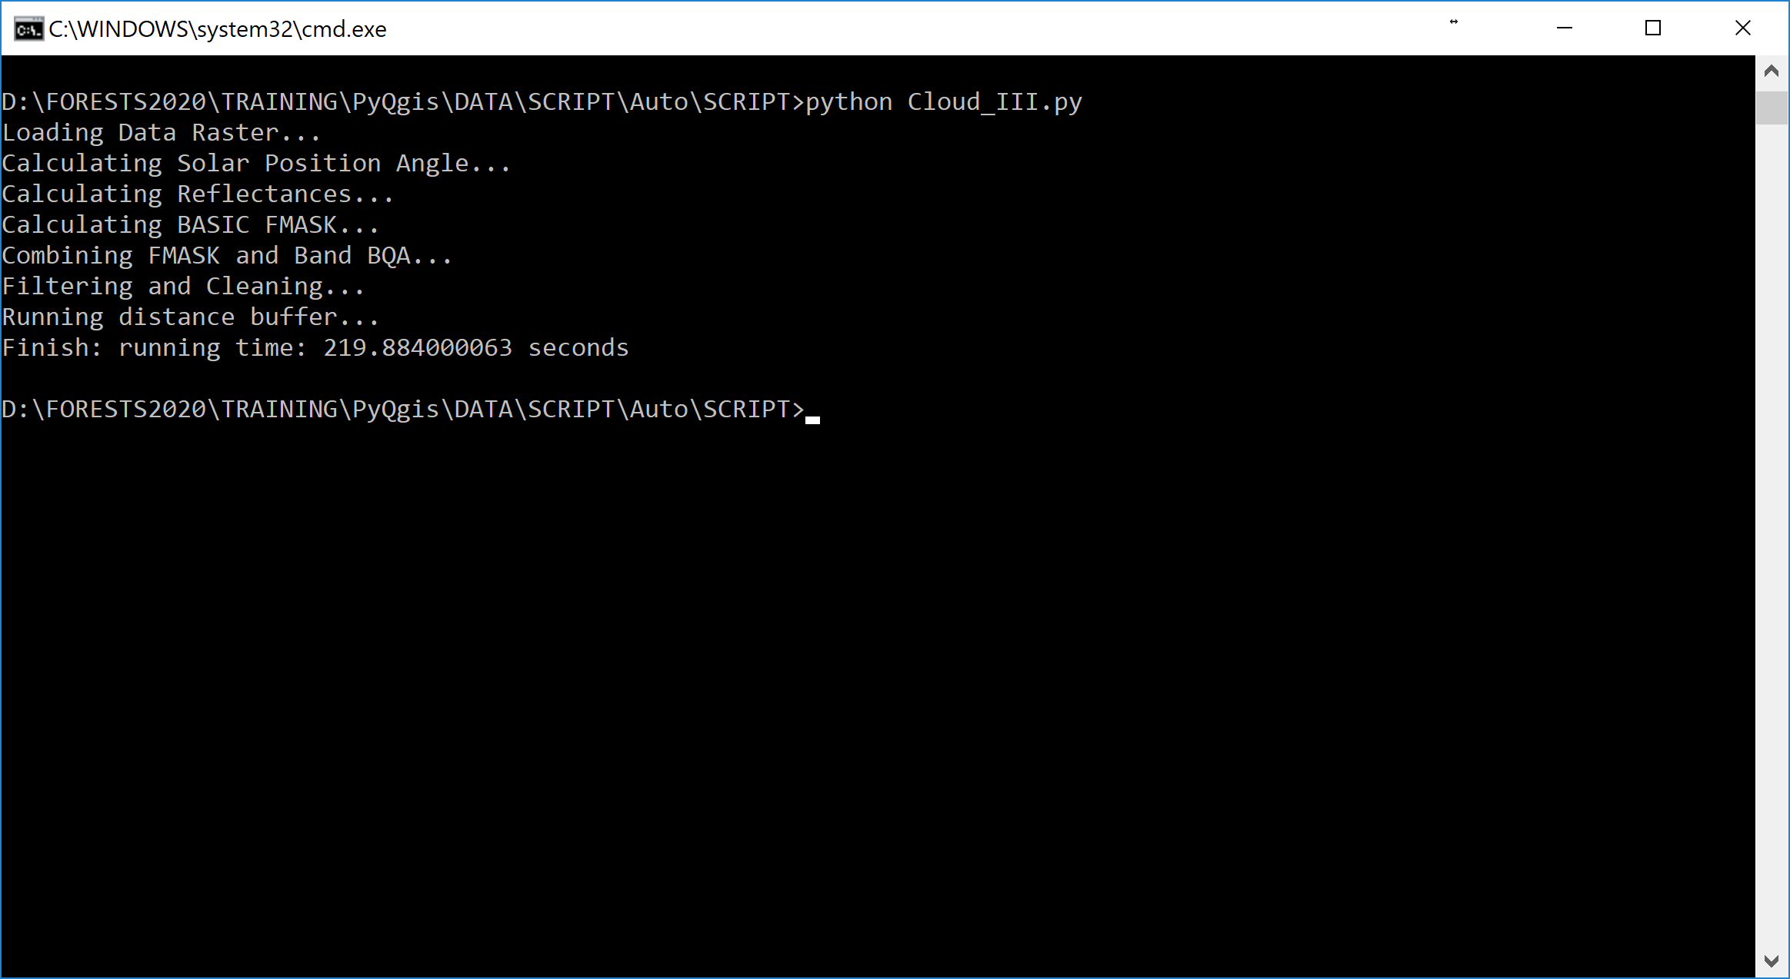
Running Time
Specification of Dell xps 13
Core i7 -7Y75 @1.30GHz
RAM 16GB

